Slide 1
System Proposal
for
Toray Composite Materials America, Inc.
Proposed solution is a cyber-physical Mass Balance Ledger that traverses the ISA-95 automation pyramid end-to-end.
Our proposed System automates traceability and reconciliation of sustainable inputs across ERP, MES, SCADA, and sensor layers to eliminate manual data stitching and ensures:
- Audit-ready,
- Tamperproof,
- Real-time,
- Continuous ISCC+
- GHG compliance.
By
Shinwa – ICE - JIT

Slide 2
TORAY composite Materials America, Inc.
Specific Asks by ISCC+
Current Solutions in the Market:
Focus on bookkeeping & reporting.
Automate SD/POS creation & packaging.
Compliance = “consistent audit docs.” Still rely on human stitching between ERP/MES/plant.
ISCC+ Demands:
Chain of Custody: Certified vs. non-certified material must be tracked across every transaction.
Mass Balance Method: Certified inputs must reconcile with outputs + declared losses.
Audit-Ready Documentation: Sustainability Declarations (SD) & Proof of Sustainability (POS) must be available for every certified batch.
Continuous Record-Keeping (APS v5.0): Real-time, continuously updated logs — no backfilled reports.
Tamperproof Evidence: Assurance that data cannot be retroactively altered.
Proposed Solution:
Chain of Custody Tracks flows across ERP ↔ MES ↔ SCADA ↔ Sensors.
Mass Balance Cyber-physical ledger reconciles every kilogram in real time.
Audit Docs (SD/POS) Generated from the ledger, not curated manually.
Continuous Records: APS v5.0-ready Immutable, live, machine-verified data.
Tamperproof Evidence: Data contracts enforce schema & validation at each ISA-95 boundary.
Shinwa – ICE - JIT

Slide 3
TORAY composite Materials America, Inc.
Key Solutions Comparison
Capability / ISCC+ Requirement | Circularise |  | Carboledger |  | Proposed Solution
ISCC PLUS templates, Audit pack – SD, POS | ✅ | Yes | ✅ | Yes | ✅ | Yes
Mass-balance Bookkeeping | ✅ | Yes | ✅ | Yes | ✅ | Yes (+ Cross-layer reconciliation)
Continuous records | 🟡 | Reports/ZIP | 🟡 | Real-time bookkeeping layer | ✅ | Ledger automatically updated through process flow
ISA-95 Data Traversal (L4→L1) | ❌ | No Claim | ❌ | No Claim | ✅ | Core Design
System-generated Evidence (Zero human stitching) | ❌ | Platform + Expert Support | ❌ | Tooling + Guidance | ✅ | Exceptions-only human review
Blockchain-backed Records | ✅ | optional | ❌ | Not needed | ❌ | Not needed / No use case
Immutable Data Contracts | ❌ | No Claim | ❌ | No Claim | ✅ | Yes
Shinwa – ICE - JIT

Slide 4
TORAY composite Materials America, Inc.
Blockchain Vs Immutable Ledgers
Context
Blockchain is often promoted for supply chain traceability and sustainability certification.
Works best when:
Multiple independent actors maintain nodes.
Trust is distributed through consensus.
Data is transparent across open ecosystems.
Why Not Here?
ISCC+ certification and carbon fiber mass balance occur within a controlled industrial ecosystem, not a public one.
Manufacturing plants don’t want production data exposed on public or consortium chains.
Blockchain adds overhead, latency, and complexity without solving the core compliance challenge.
Key Insight
What ISCC+ needs is authentic correlation across ISA-95 layers, not a distributed consensus protocol.
MATRIX-95 provides this with an immutable ledger, tamperproof yet efficient, within the enterprise’s security perimeter.
Shinwa – ICE - JIT

Slide 5
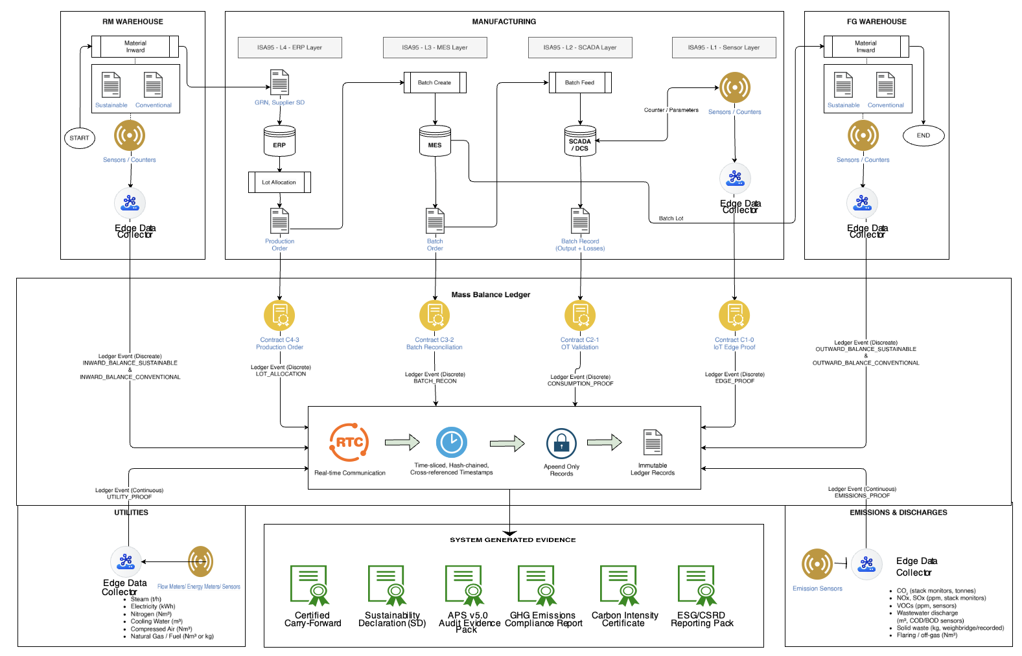
TORAY composite Materials America, Inc.
Shinwa – ICE - JIT

Slide 6
TORAY composite Materials America, Inc.
Work In progress…
Shinwa – ICE - JIT

